Slide 1

FALSE GOSPEL
Christian Nationalism in Modern America

Slide 2

The Temptation of Jesus
Jesus, full of the Holy Spirit, returned from the Jordan and was led by the Spirit in the wilderness, where for forty days he was tested by the devil.
Then the devil led him up and showed him in an instant all the kingdoms of the world. And the devil said to him, “To you I will give all this authority and their glory, for it has been given over to me, and I give it to anyone I please. If you, then, will worship me, it will all be yours.”
Jesus answered him, “It is written, ‘Worship the LORD your God, and serve only him.’”
Luke 4: 1-2, 5-8

Slide 3


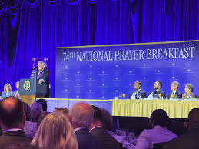


Slide 4

Part 1: Theology

Slide 5
What is Christian Nationalism?
Sociologists Andrew Whitehead and Samuel Perry offer this definition:
“Christian Nationalism is a cultural framework - a collection of myths, traditions, symbols, narratives and value systems - that idealizes and advocates a fusion of Christianity with American civic life.”
It “paradoxically holds America as sacred in God’s sight while viewing its future as tenuous and bleak. It valorizes conquests in America’s name and blood shed in its defense. It idealizes relations marked by clear (metaphorical or physical) boundaries and hierarchies in both the private and public realms. It baptizes authoritarian rule. It justifies the preservation of order with righteous violence…”
Whitehead and Perry, Taking America Back

Slide 6
The “Christian” Part of Christian Nationalism
Whitehead and Perry, cont.
“The ‘Christianity’ of Christian Nationalism represents something more than religion… It includes assumptions of nativism, white supremacy, patriarchy, and heteronormativity, along with divine sanction for authoritarian control and militarism. It is as ethnic and political as it is religious. Understood in this light, Christian nationalism contends that America has been and should always be distinctively ‘Christian’... from top to bottom - in its self-identity, interpretations of its own history, sacred symbols, cherished values, and public policies - and aims to keep it that way.”
This is a far cry from the religion of Jesus.

Slide 7
Compare to these passages from Matthew’s Gospel:
Matthew 5:5 - Blessed are the meek, for they will inherit the Earth.
Matthew 5:9 - Blessed are the peacemakers, for they will be called children of God
Matthew 5:44 - But I say to you, Love your enemies and pray for those who persecute you.
Matthew 7:1-2 - Do not judge, so that you may not be judged. For with the judgment you make you will be judged, and the measure you give will be the measure you get.
Matthew 25:34-36 - Come, you that are blessed by my Father…for I was hungry and you gave me food, I was thirsty and you gave me something to drink, I was a stranger and you welcomed me, I was naked and you gave me clothing, I was sick and you took care of me, I was in prison and you visited me.

Slide 8
Some Early Precursors
1493 - Doctrine of Discovery under Pope Alexander VI - Divine right to claim non-Christian lands and labeling of non-Christian people as “sub-human.”
Interpretation of “Curse of Ham” in Genesis as expounding a divinely ordained racial hierarchy
1500’s - Martin Luther and the proliferation of Sola Fide theology
1807 - Publication of the Slave Bible, which excised over 90% of the Hebrew Scriptures and over 50% of the Christian Scriptures
Mid-1800’s - Manifest Destiny; Settlers as “New Israelites,” Indigenous peoples labeled “Canaanites”

Slide 9
John Nelson Darby and Dispensationalism
Darby (1800-1882) was an untrained Anglican clergyman who is considered to be the major force behind modern day Premillennial Dispensationalism, i.e., Rapture Theology.
Darby believed “that God worked differently with humanity in different periods of time, or Dispensations.”
Humanity had entered the final Dispensation, and it was the task of the church to speed along Christ’s return.
Darby’s theology was generally unpopular in his native Britain and Europe, but found purchase in America, with its inclusion in the 1909 Scofield Reference Bible.
The Pretribulation Rapture Doctrine and the Progressive Dispensational System by John A. Alifano, 2004
Notes:
Appeals to American Exceptionalism

Slide 10
Dominionism
Major Figures - Francis Schaeffer (A Christian Manifesto), R. J. Rushdoony (The Institutes of Biblical Law, Theonomy), Tim LaHaye (Left Behind)
Builds on Darby’s view of the End Times (Eschatology)
Believes that in order to bring about the End Times, Christians must establish (or re-establish) Dominion over Western culture - specifically American culture, as America is seen to have once had, but subsequently lost (due to whatever the particularly egregious sin of the month is), special favor with God. Also deeply tied to Zionism.
Term taken from Genesis 1:26-27
The Psychology of Christian Nationalism, Pamela-Cooper White, 2022
Notes:
26 Then God said, “Let us make humans[c] in our image, according to our likeness, and let them have dominion over the fish of the sea and over the birds of the air and over the cattle and over all the wild animals of the earth[d] and over every creeping thing that creeps upon the earth.”
27
So God created humans[e] in his image,
in the image of God he created them;[f]
male and female he created them.

Slide 11
The Seven Mountains Mandate
While Dominionism was initially focused on governmental control, it was later expanded to seven spheres or “mountains,” the term coming from Revelation 17:9
In addition to government, the Seven Mountain Mandate calls for conservative Christians to infiltrate and control the spheres of Family Life, Religion, Education, Media, Arts & Entertainment, and Business.
This theology can be tied to the rise of groups like Moms for Liberty running for school board positions, the Quiverfull movement and “Mom Tok,” etc., and is deeply ingrained in Project 2025.
https://www.usatoday.com/story/news/investigations/2024/03/07/trump-christian-nationalism-extremist-threat/72869355007/
Notes:
Project 2025: Replacement of civil service workers with those loyal to the CN agenda, rollback of rights and environmental protections, prosecution of “anti-white racism”

Slide 12
Religious Right, Moral Majority, and Focus on the Family
1971 - Green v. Connally - Confirmed the right of the IRS to revoke tax-exempt status for segregated schools - Used as precedent to rule against Bob Jones University in 1983
1977 - James Dobson founds Focus on the Family
1979 - Jerry Falwell founded Moral Majority, pivots from racial issues to “social morality.”
Common rhetoric (which continues to this day) of seeing Christians as in the midst of a battle for the soul of America - both from Communism and Immorality (feminism, LGBTQ rights, secularism)
Kristin Kobes Du Mez, Jesus and John Wayne, 2020

Slide 13
How Christianity Became Capitalist
Abraham Vereide - Methodist clergyman who felt called to minister to the so-called “Up-and-Out” during the Great Depression
Believed that a Wealthy Chosen Few should be responsible for Charity, as opposed to a Welfare state.
Created “The Foundation,” also called “The Family,” as a group opposed to FDR’s New Deal. Creators of the National Prayer Breakfast.*
James Fifield - Famous speech at 1940 N.A.M. conference, sought to rehabilitate image of the wealthy through the pulpit. “Christian Libertarianism” became the predecessor to…**
*Monte Mader, Flipping Tables - Ep. 42, The Family - Christian Nationalist Power
**Kevin M. Kruse, “How Corporate America Invented Christian America” Politico, 2015

Slide 14
The Prosperity Gospel
“White Christian Nationalism has nothing good to say about the poor, and poverty is often described as a character flaw.” “The Preachers of the Prosperity Gospel…consider those with more wealth to be ‘blessed’ while those with less to be without adequate faith” - Jim Wallis, False White Gospel
Has roots in “New Thought” movements (manifestation/ “positive confession”), sees scripture in terms of a “contract” between God and humanity. Also leans heavily on Dominion theology, seeing these promises as God’s victory over secular forces.
T.D. Jakes, a major figure in the Prosperity movement, has reportedly preached on the “demonization of success” and “views poverty as a barrier to living a Christian life.*
Jonathan Walton, Watch This! The Ethics and Aesthetics of Black Televangelism

Slide 15
Ironically, many Christian Nationalists tend to be quite poor themselves. Christian Nationalists are overwhelmingly rural and undereducated, holding strong anti-immigrant/nativist beliefs and a general distrust of urban, educated, and wealthy “elites.”*
This creates an intense cognitive dissonance. Why am I, a faithful Christian, not receiving God’s blessing?
This framework thus requires a scapegoat, a group to blame God’s inability or unwillingness to render those promised blessings.
*Pamela Cooper-White, Psychology of Christian Nationalism
The Prosperity Gospel, Cont.

Slide 16
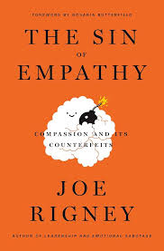

The Demonization of Empathy
Recently, the Christian Right has started to label empathy as “counterfeit compassion.”
Joseph Rigney, in his Calvinist framework, sees suffering as the result of sin, and empathy as something which draws people towards excusing sin or ameliorating its consequences.
Compassion, on the other hand, is meant to draw people back into his idea of biblical truth.

Slide 17
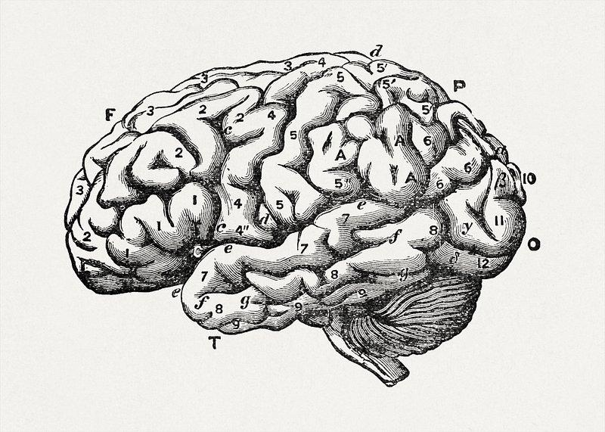
PART 2: PSYCHOLOGY

Slide 18
Structural Differences
Studies have shown that people who lean conservative tend to have more grey matter mass in their Amygdalas (specifically on the right side), the part of the brain that governs threat detection, fear processing, and fight or flight responses. While less robust, there is also some data suggesting a more developed Insula, which governs feelings of disgust (a common feature of conservative psychology).
People who lean liberal, on the other hand, have been shown to on average have more grey matter in their Anterior Cingulate Cortex, a part of the brain associated with empathy, error detection, the ability to change one’s mind, and to tolerate uncertainty.
Kanai R, Feilden T, Firth C, Rees G. Political orientations are correlated with brain structure in young adults. Curr Biol. 2011 Apr 26;21(8):677-80. doi: 10.1016/j.cub.2011.03.017. Epub 2011 Apr 7. PMID: 21474316; PMCID: PMC3092984.

Slide 19
Moral Foundations Theory
Social Psychologist Jonathan Haidt identifies six dimensions of moral reasoning:
Care/Harm
Liberty/Oppression
Fairness/Cheating
Loyalty/Betrayal
Authority/Subversion
Sanctity/Degradation
On the whole, Liberal people make moral judgments based primarily on the first 3 dimensions, with 1&2 holding the most weight.
Conservatives make decisions based on all 6, and also understand them differently, i.e. fairness being understood as commensurality instead of equity.
Jonathan Haidt, The Righteous Mind, 2012

Slide 20
The Ease of Conservative Appeal
Christian Nationalist rhetoric is effective because it triggers multiple dimensions of moral outrage in ways that Progressive rhetoric does not.
The government wants to give healthcare to migrants when I can’t afford my medication (Care Outrage)
The Liberals are telling me I can’t say Merry Christmas (Liberty Outrage)
The “illegals” are getting resources they haven’t earned (Fairness Outrage)
The Muslims are un-American, and want to bring Sharia Law (Loyalty Outrage)
The protesters are attacking law enforcement (Authority Outrage)
The Trans people are offensive to God’s design (Sanctity Outrage)

Slide 21
More on Disgust
Relating to the Sanctity dimension, Disgust has been effectively wielded by those on the Right to target marginalized groups. Most often seen with LGBTQ+ folks (Demonization of HIV, Trans Individuals as violating bodily integrity) but also stories about “Furries” using litter boxes in schools, Haitians eating pets, etc.
Evangelical Christianity makes significant use of Purity language, especially around sexuality, but also broadly in their theology of redemption (“Washed clean by the blood of Jesus”).
Several studies out of the University of Toronto have demonstrated that people conflate feelings of physical uncleanness with moral uncleanness, and have even shown that people get more conservative when in the presence of garbage or strong, unpleasant odors; however, so too can the feeling of being clean.*
*Zhong, Strejcek, and Sivanathan, A Clean Self Can Render Harsh Moral Judgment, 2010

Slide 22
Fear & Shame
Salmela & von Scheve, Emotional Roots of Right-Wing Political Populism, 2017
“Emotional processes that affect people’s identities provide an additional explanation for the current popularity of the new radical right, not only among low- and medium-skilled workers, but also among the middle classes whose insecurities manifest as fears of not being able to live up to salient social identities and their constitutive values, and as shame about this actual or anticipated inability. This link between fear and shame is particularly salient in contemporary capitalist societies where responsibility for success and failure is increasingly individualized, and failure is stigmatized through unemployment, receiving welfare benefits, or labor migration. Under these conditions, we identify two psychological mechanisms behind the rise of the new populist right. The first mechanism of ressentiment explains how negative emotions – fear and insecurity, in particular – transform through repressed shame into anger, resentment and hatred towards perceived ‘enemies’ of the self and associated social groups, such as refugees, immigrants, the long-term unemployed, political and cultural elites, and the ‘mainstream’ media. The second mechanism relates to the emotional distancing from social identities that inflict shame and other negative emotions, and instead promotes seeking meaning and self-esteem from aspects of identity perceived to be stable and to some extent exclusive, such as nationality, ethnicity, religion, language and traditional gender roles.”

Slide 23
Salmela & von Scheve, cont. - Ressentiment
Ressentiment, a term first coined by Nietzsche, is the state which arises from the repression and transformation of feelings of “envy, hatred, malice, or spite towards another person or persons in situations where one feels impotent to act on one of those emotions.”
This feeling can also be understood as a shame which leads to actions with the explicit goal of compensating for those feelings of powerlessness.
This creates a perpetual victim mentality, which is especially easy for charismatic populists to take advantage of.
It also likely ties into the trend of “Masculine” or “Muscular” Christianity, which is deeply ingrained in Christian Nationalist theology.

Slide 24
The Christian Nationalist Cult
“It is a completely immersive culture. If culture is defined by a combination of social, political, and religious beliefs with food, dress, artistic expression, and ethnicity, then Christian nationalism readily fits the definition. It excludes and derides those who do not fit in a majority of those categories, particularly in their beliefs but also in many of the other markers of cultural belonging. But its exclusivity also reflects a layer of dread - of losing this culture, being “replaced” by a liberal America that its members fear - and this fear leads to hate.”
Churches use cult induction tactics like:
Love bombing
Gradual separation from social life
Control of access to information
Inducing guilt for deviation
Revision of personal history (through witnessing/sharing transformation)
“Purification of Ego” i.e. Letting go of one’s critical thinking and subjectivity
“Incessant Urgency”
Pamela Cooper-White, Psychology

Slide 25
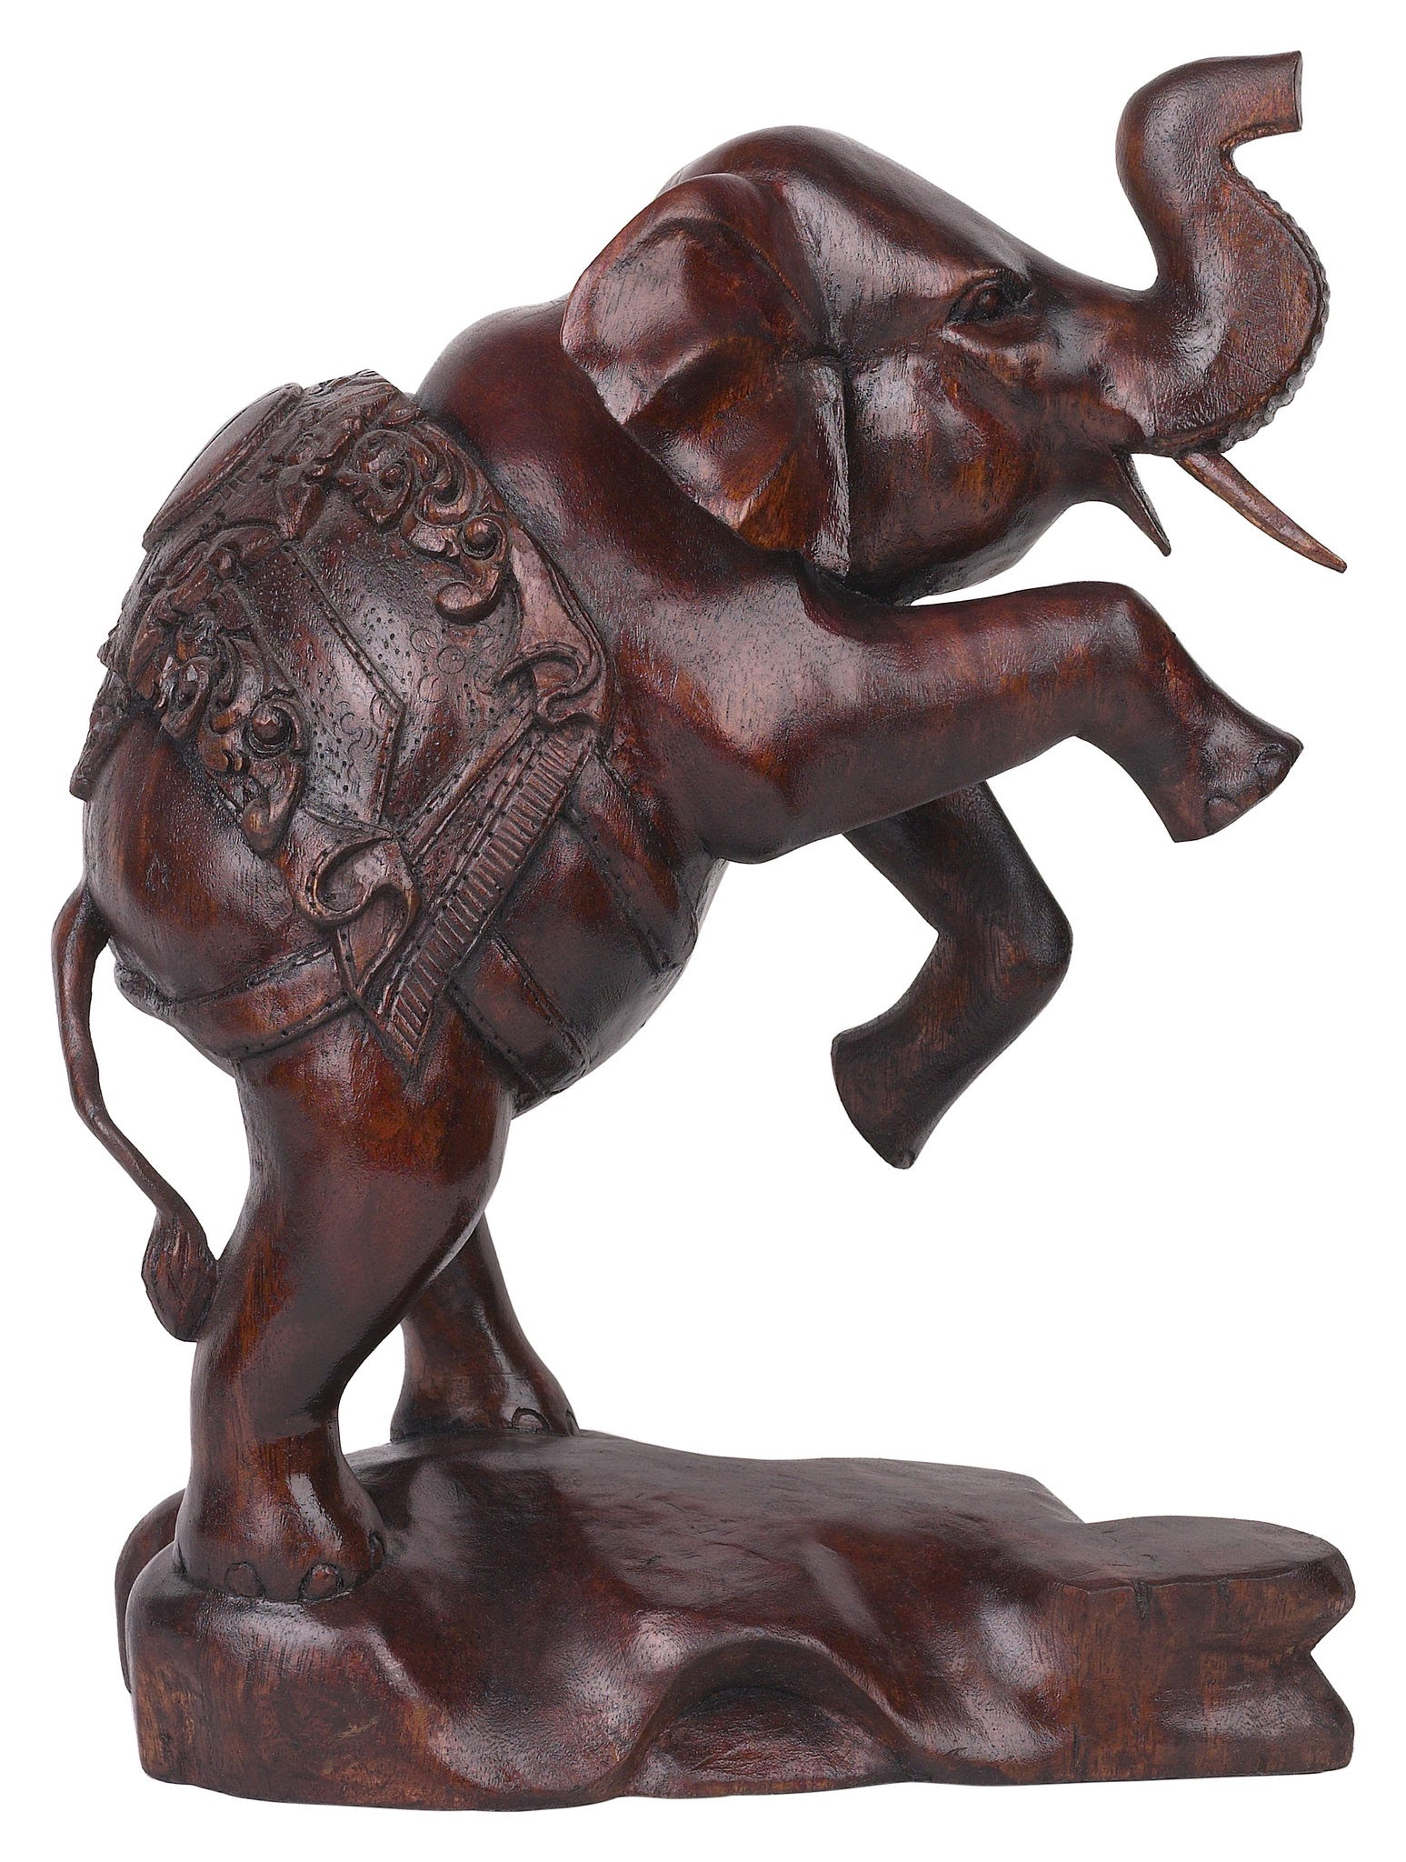
Haidt’s Elephant
“Intuitions come first, strategic reasoning second.”
Jonathan Haidt contends that we experience moral reactions first as intuition, then as judgment, then on the rational level, comparing it to a person riding an elephant. The person likes to think they’re in charge, but how much control do they really have over the elephant?

Slide 26
Part 3:
So What Do We Do?

Slide 27




Love People
Resist Empire

Slide 28

Step 1: Pop the Bubble
Remember, Christian Nationalism (as well as MAGA, White Supremacy Groups, etc.) are effectively cults. They are conditioned to see anyone outside of the group as evil, immoral, or an enemy.
People in these groups live and move in echo chambers. Their views are reinforced in every social interaction and every piece of media they consume. Their social media algorithms are tailored to elicit those feelings of threat, anger, and disgust.
Here are some stories of how people got out:

Slide 29

Monte Mader, Host of Flipping Tables and Singer for Monte and the Monsters
A friend at Liberty University who confronted her about a Confederate Flag Keychain she carried, asking her “how would black folks seeing that feel?”
The sexual assault and resulting pregnancy a 12-year old girl with whom she was close. Having grown up being told that pregnancy can never result from rape, she delved into research around reproductive health.

Slide 30

Tim Whitaker, Host of The New Evangelicals Podcast
“It wasn't the people calling me a bigoted asshole online that got me to rethink my positions. It was friends. It was my first gay coworker I ever met that totally blew apart my preconceived notions of what it meant to be gay.
Those little seeds were planted that led me to be more and more curious.”

Slide 31
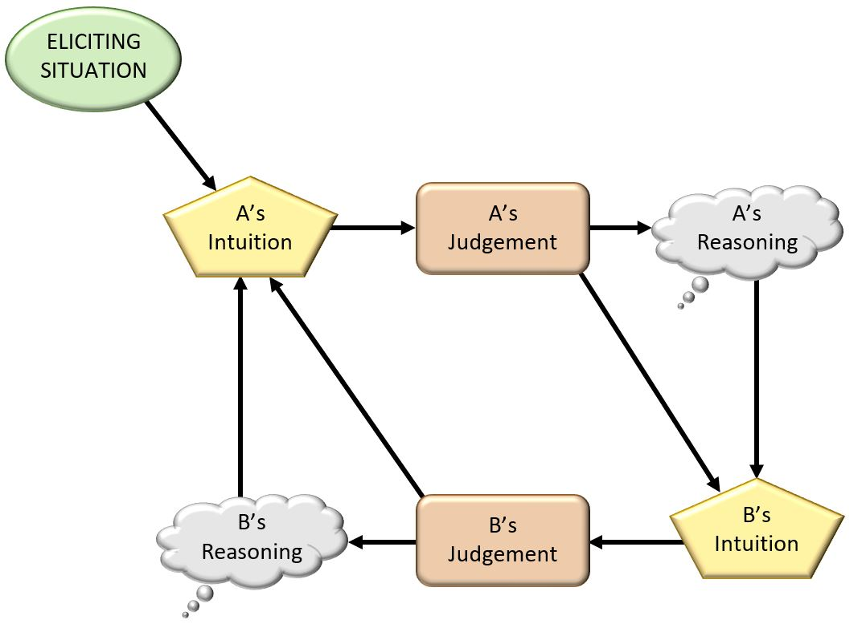
Social Intuitionist Model - Disruptive Relationships
Notes:
Nothing happens without personal disruption.

Slide 32
Bite Your Tongue - At Least At First
“Friends can do for us what we cannot do for ourselves: they can challenge us, giving us new reasons and arguments that sometimes trigger new intuitions, thereby making it possible for us to change our minds.”
“We are terrible at seeking evidence that challenges our own beliefs, but other people do us this favor, just as we are quite good at finding errors in other people’s beliefs. When discussion are hostile, the odds of change are slight. The elephant leans away…But if there is affection, admiration, or a desire to please the other person, then the elephant leans towards that person and the rider tries to find the truth in the other person’s arguments.”
Jonathan Haidt, The Righteous Mind

Slide 33

There are two primary ways people break out of cults:
1. A betrayal of their values so profound from within that it leads to disillusionment and a regaining of critical faculties, or
2. A connection with someone outside of the cult that is more genuine than those within the cult.
https://research.open.ac.uk/news/how-get-someone-out-cult-and-what-happens-afterwards

Slide 34
People with conservative dispositions are primed for a fight, both by the rhetoric at work in their echo chambers, and possibly also by their very brain structure.
Going on the offensive, especially when they say something offensive, is a temptation we have to resist until such a point where trust, connection, and empathy has been built. Model curiosity, and invite them into it.
Ask questions about why they feel the way they do, express that you have had different experiences, and if you feel like you must disagree, do so in a way that suggests you wish to continue to have a relationship, whatever the nature of that relationship may be.
Remember, it’s hard to hate up close. Love them better than the cult.

Slide 35

How to Respond to the Theology
Christian Nationalists have what most other Christian-identifying people would consider a regressive view of the Bible, which uplifts the Levitical laws over the teachings of Jesus - though they are often blind to this fact.
They call for the Ten Commandments to be displayed in classrooms, but not the Sermon on the Mount.
Fundamentally, their hypermasculine, dominating, hierarchical theology cannot square with the teachings of Jesus, nor the teachings of the Hebrew prophets.
A level of scriptural literacy is critical here. We need to be able to speak their language, and reclaim the narrative of the Bible from the Christian Right.

Slide 36
Jesus’ Relation to Biblical Law
In Matthew 5:17, Jesus says “Do not think that I have come to abolish the Law or the Prophets; I have come not to abolish, but to fulfill. For truly I tell you, until heaven and earth pass away, not one letter, not one stroke of a letter, will pass from the law until all is accomplished. CN’s often interpret this in terms of the Old Testament remaining applicable, but could also be understood as being brought to completion.
Matthew’s gospel, often called “The Gospel to the Jews,” pays special attention to how Jesus fulfills certain prophecies, such as his being a Nazarene, or his tendency to speak in parables; it also shows Jesus as having the authority to reinterpret the Law.
Finally, Jesus establishes a New Covenant at the Last Supper, and on the cross says, “It is finished.” According to their own theology, Jesus is the last word on biblical morality.

Slide 37
Remember:
KEEP FIGHTING. KEEP LOVING.
We must operate on both the personal and the social level, with grace for people and fierce opposition towards systems of oppression, as modeled by prophetic figures throughout history, like Jesus.
Flip Tables.
Welcome the stranger.
Call out hypocrisy.
Set the prisoners free.

Slide 38

Unitarian Universalism’s Role
We model community in the midst of holding disparate theologies.
We honor the plurality of human experience.
Our roots are in the Christian tradition, and thus we have claim to these texts.
We embody the social gospel in our embodied service - centering the marginalized, uplifting the needs of the many, protecting the vulnerable, and sharing our resources.

Slide 39
Resources:
Podcasts:
Flipping Tables; The New Evangelicals; The Tim & April Show
Books:
The Psychology of Christian Nationalism by Pamela Cooper-White
Jesus and John Wayne by Kristin Kobes Du Mez
The False White Gospel by Jim Wallis
The Righteous Mind: Why Good People are Divided by Politics and Religion by Jonathan Haidt
Separation of Church and Hate by John Fugelsang

